Slide 1

Sweet Karoline’s Cakes Business Process Automation Proposal
By silver souls:
Adam Schweitzer, nick gay, nick Taylor, ben benoit, Matt Holston, Alex Mattingly

Slide 2
Current Problems
Customer Accessibility
Coordinating Communications
BUSINESS Exposure
Business Continuity
Notes:
Business Continuity: Want to make business stable and have a reliable system in place

Slide 3
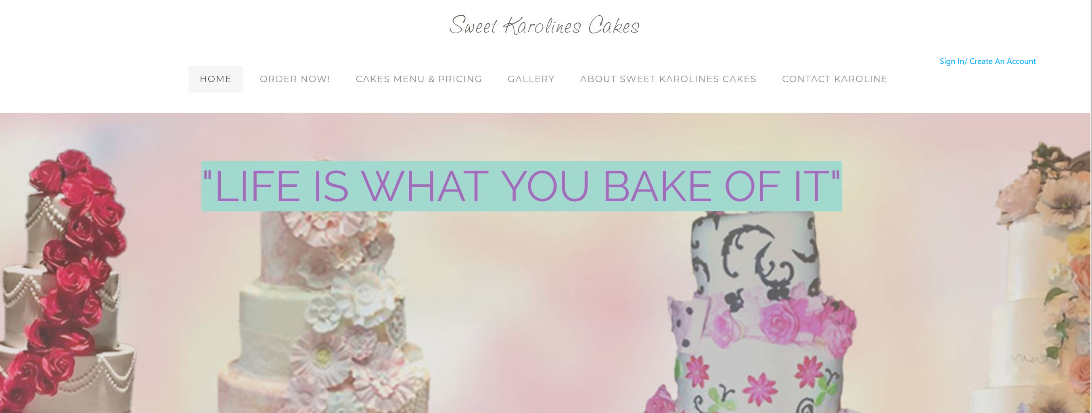
Prototype - Homepage

Slide 4
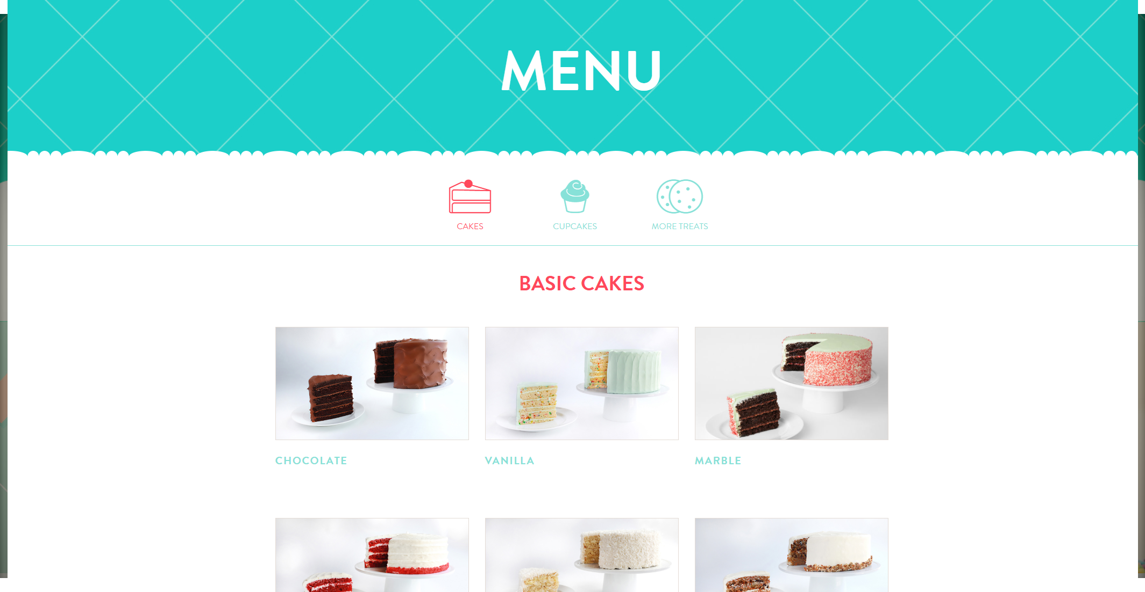
Prototype - Menu

Slide 5
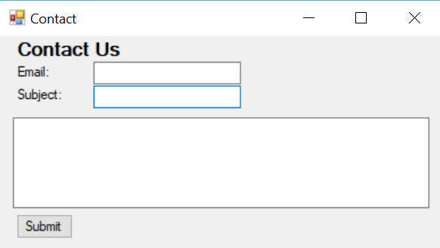
Prototype – Contact Us

Slide 6


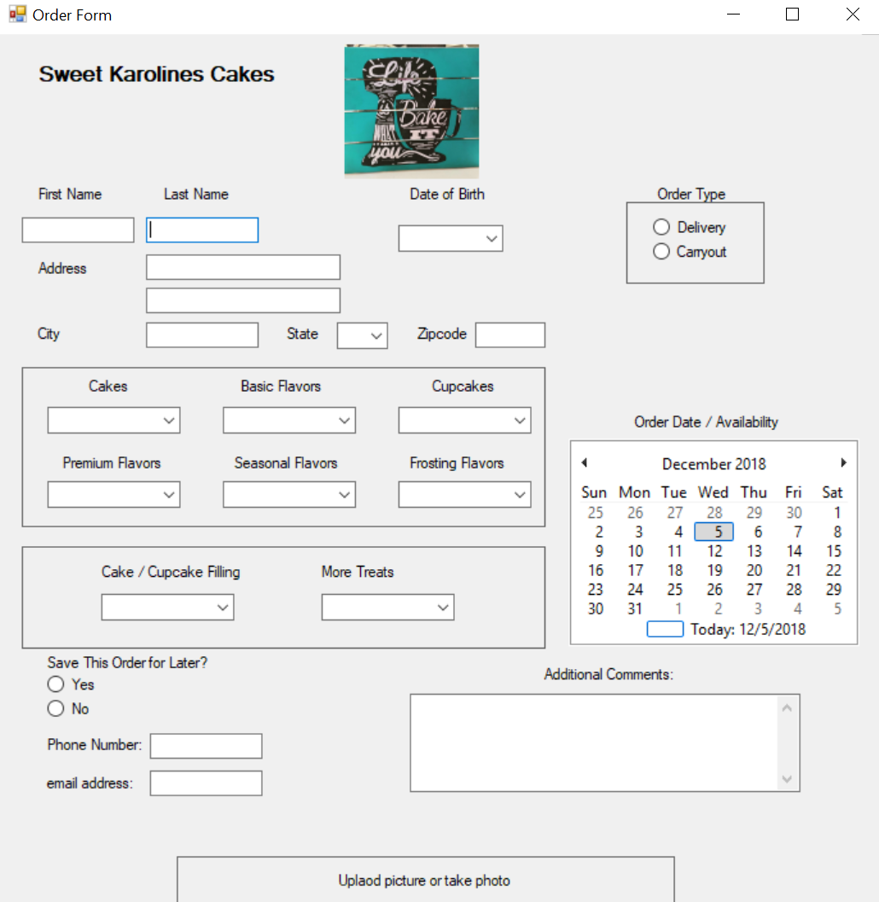



Prototype – Order Form

Slide 7
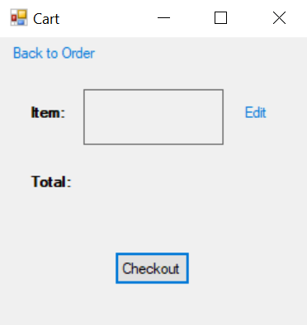
Prototype - Cart

Slide 8
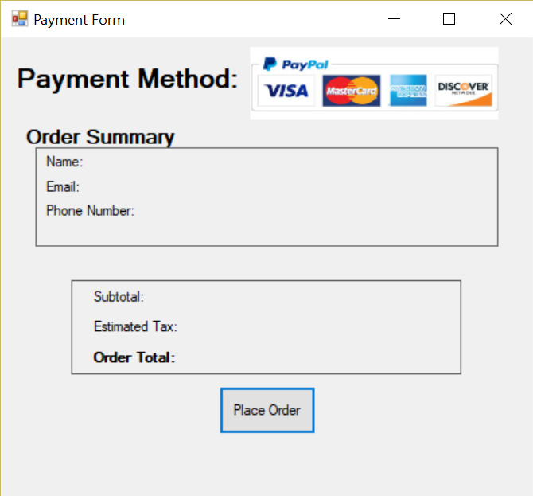
Prototype – Payment Form

Slide 9
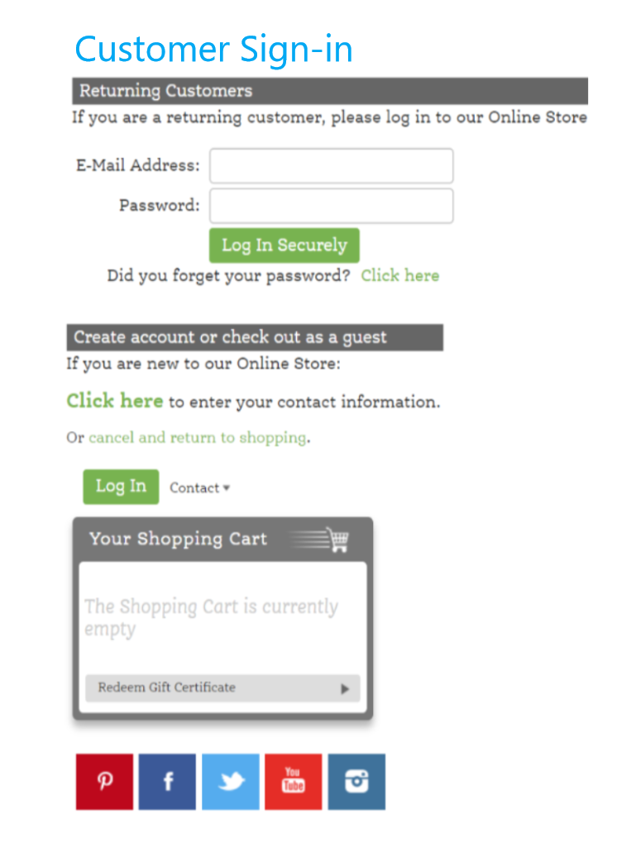
Prototype – Customer Sign-in

Slide 10
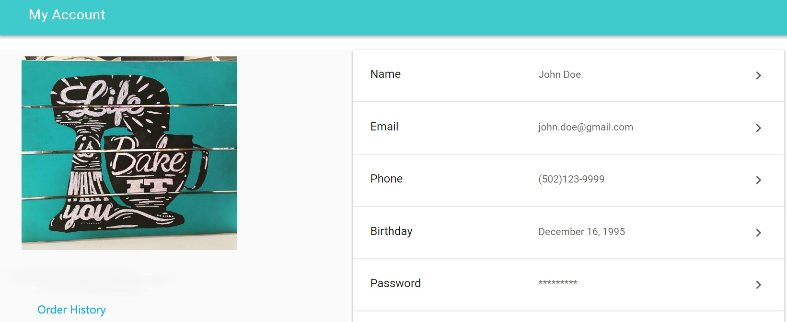
Prototype – Customer Account

Slide 11
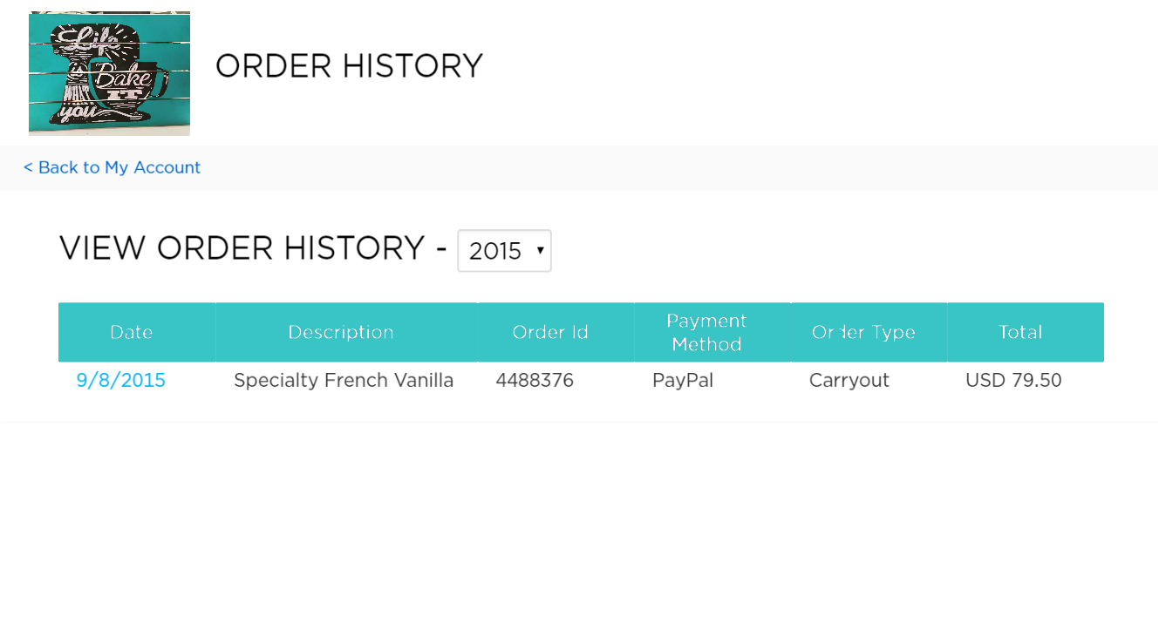
Prototype – Order History

Slide 12
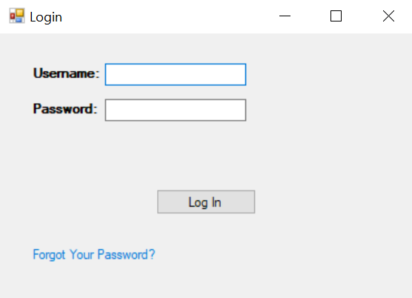
Prototype – Admin Login

Slide 13
In conclusion, our system…
Makes ordering easy
Streamlines communication
Will expose new CUSTOMERS to your brand
Will increase revenue

Slide 14

Any Questions?
Notes:
Ask if there are any questions. If none, thank Karoline for her time and appreciate the opportunity to present to her.

